Slide 1
EF Code First
15-Mar-18 | Start
Appendix
Online

Slide 2
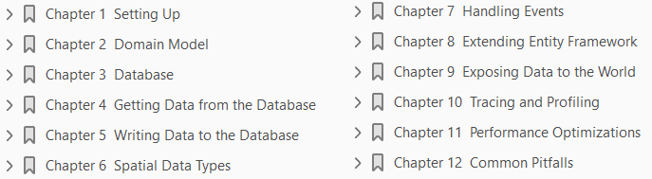
EF Code First
Ch | Date
1
2
3
4
5
6
7
8
Entity Framework Code First Succinctly Mar 2018

Slide 3
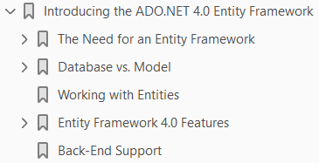
1
Introduction to ADO.NET 4.0 Entity Framework

Slide 4
Before We Start
Before you start using EFCF, you need to have its assemblies deployed locally.
The distribution model followed by Microsoft and a number of other companies does not depend on old school Windows installers, but instead relies on new technologies such as NuGet and Git.
Make sure you have Visual Studio 2012 installed (any edition including Visual Web Developer Express will work), as well as SQL Server 2008 (any edition including Express) or higher.
On SQL Server, create a new database called Succinctly.

Slide 5

Getting EF Code First from NuGet
NuGet is to .NET package management what Entity Framework is to data access.
It allows Visual Studio projects to have dependencies on software packages—assemblies, source code files, PowerShell scripts, etc.—stored in remote repositories.
EFCF comes in its own assembly, which is deployed out-of-band between regular .NET releases.
In order to install it to an existing project, first run the Package Manager Console from the Tools > Library Package Manager and enter the following command.

Slide 6

Getting EF Code First from CodePlex
The second option, for advanced users, is to
clone the Entity Framework Code First repository on CodePlex
build the binaries yourself, and
manually add a reference to the generated assembly
Let’s start by cloning the Git repository using your preferred Git client.
Next, build everything from the command line using the following two commands.

Slide 7
Configuring the Database
Entity Framework is database-agnostic, but the standard version only includes providers for Microsoft technologies.
This means only SQL Server 2005+, SQL Server Compact Edition, and SQL Server Express LocalDB are supported.
Entity Framework decides on what connection to use by executing the following algorithm.
If a connection string is passed in the DbContext’s constructor, then it will try to use that connection string with the default connection factory.
If the parameter-less constructor is used, it will look for a connection string in the configuration file, where its name is the same as the context’s class.
If no connection string is passed and no connection string with an appropriate name is found in the connection string, it will try to connect to a SQL Server instance named SQLEXPRESS, and a database with the same name as the context class, including namespace.
A connection factory is an implementation of IDbConnectionFactory that sits in a well-known location: Database.DefaultConnectionFactory.
This instance can be explicitly set, and should be if a specific database engine requires it.
This can be done either by code or by setting a value in the configuration file (Figure 1-1).

Slide 8
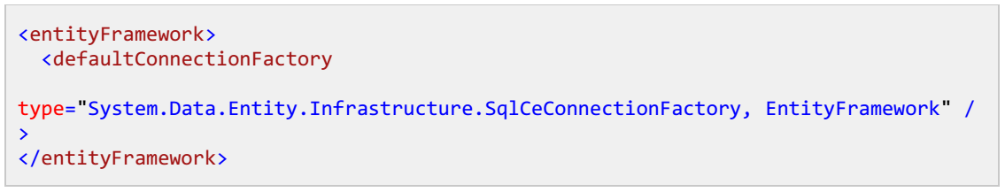
Figure 1-1

Slide 9
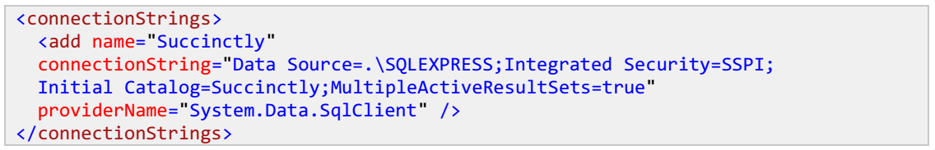
SQL Server
For connecting to the SQL Server, no special action is required.
The default Database.DefaultConnectionFactory is already an instance of SqlConnectionFactory.
If you want to have a connection string in the configuration file, you should use the provider name “System.Data.SqlClient” as per the following example.

Slide 10
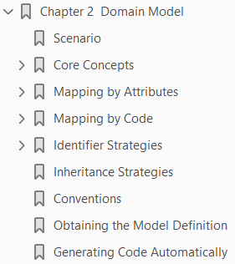
2
Domain Model

Slide 11
Scenario
Let’s consider the scenario in Figure 2-1 as the basis for our study.
Let’s try to make some sense out of them:
A Customer has a number of Projects.
Each Project has a collection of ProjectResources, belongs to a single Customer, and has a ProjectDetail with additional information.
A ProjectDetail refers to a single Project.
A ProjectResource always points to an existing Resource and is assigned to a Project with a given Role.
A Resource knows some Technologies and can be involved in several Projects.
A Technology can be collectively shared by several Resources.
Both Customers and Resources have Contact information.

Slide 12
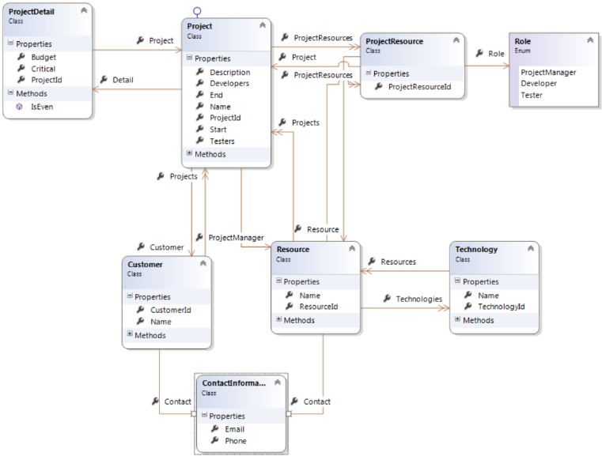
Figure 2-1

Slide 13
Core Concepts
Before a class model can be used to query a database or to insert values into it, Entity Framework needs to know how it should translate code (classes, properties, and instances) back and forth into the database (specifically, tables, columns and records).
For that, it uses a mapping, for which two APIs exist.
Let’s understand the core concepts involved as follows:
Contexts
Entities
Complex Types
Scalar Properties
Identity Properties
References
Collections

Slide 14
Contexts
A context is a class that inherits from DbContext and which exposes a number of entity collections in the form of DbSet<T> properties.
Nothing prevents you from exposing all entity types, but normally you only expose aggregate roots, because these are the ones that make sense querying on their own.

